Slide 1
Code analyze SQL code and schema – for fun and profit!​
@ErikEJ

Slide 2
Why fun? Why profit?
Fun is learning new things that add value
Profit is shifting left
Shifting left is expert help with database design

Slide 3
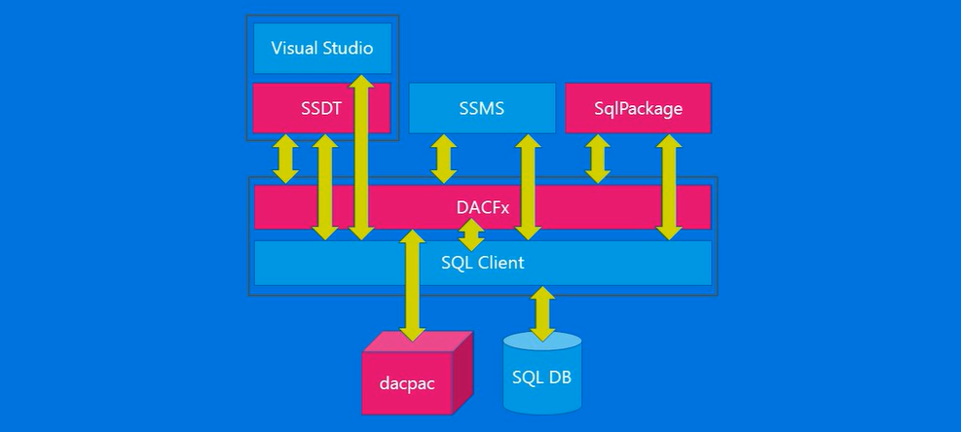

Slide 4
Demo!

Slide 5
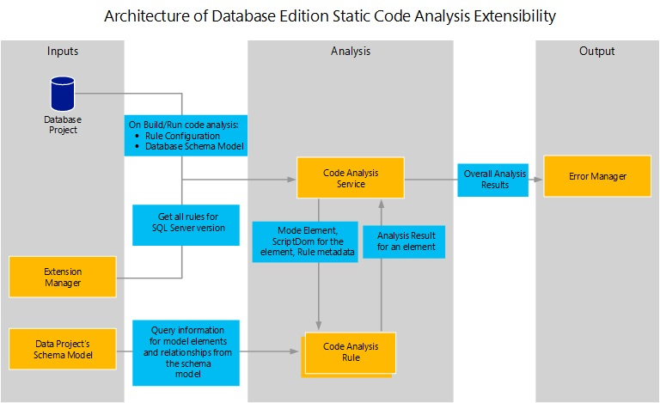

Slide 6
Demo!

Slide 7
Database project / MSBuild.SDK.SqlProj
 | .SQLPROJ (DB project) | MSBuild.SDK.SqlProj
Create a .dacpac | ✔ | ✔
Run Code Analysis | ✔ (15 rules) | ✔ (50+ rules)
Run custom rules | ✔ (admin access) | ✔
Run rules on hosted agent | ✔ | ✔
Run custom rules on hosted agent | ❌ | ✔
Build on Linux (dotnet build) | ❌ | ✔
Visual designers | ✔ | ❌

Slide 8

CTA
Add you database schema to source control
Enable code analysis locally and in CI
Optional: Create your own rules and contribute them back to the community
Q & A

